Slide 1


Market Retail Analysis
Presented by:
Sharjil Shah
DSBA – Jan’22A
Great Learning

Slide 2
Agenda
Problem Statement:
The data set provided to you is the data set of a Café Chain for one of its restaurants. Do a thorough analysis of the data and come up with the following analysis.
The owner of the restaurant wants you to use this data to come up with a set of recommendations that can help his Café Chain increase its revenues. He is able to provide you with a data set for POS (point of sale data) for one of his chains.
Dataset: Cafe_Data_MRA.xlsx

Slide 3
Contents
Menu Analysis
02
Exploratory Data Analysis
01

Slide 4
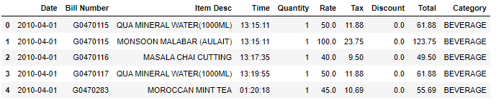
Exploratory Analysis of data & an executive summary supported by graphs.
We uploaded the data set in to Jupyter notebook. Used various libraries such as pandas, seaborn, matplotlib in Python language for Exploratory data analysis. ]
We checked the top 5 rows in the data set.
The data set has 10 columns.

Slide 5

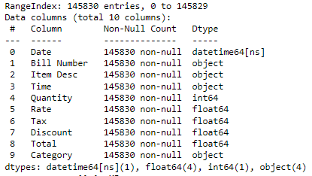
The shape of the data set: There are 145830 rows and 10 columns
The names of the columns in the Café data set listed below.
Date, Bill Number, Item Desc , Time, Quantity, Rate, Tax, Discount, Total , and Category.
Information about the data frame:

Slide 6
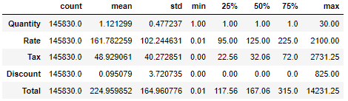
There are 4 continuous variables and 4 categorical variables and 1 date time datatype variable.
Descriptive Statistics summary:

Slide 7
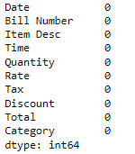
Determined null values in the data set, if any. There are no null values in the data set.
Since we do not have null values, there is no scope for null value treatment.

Slide 8
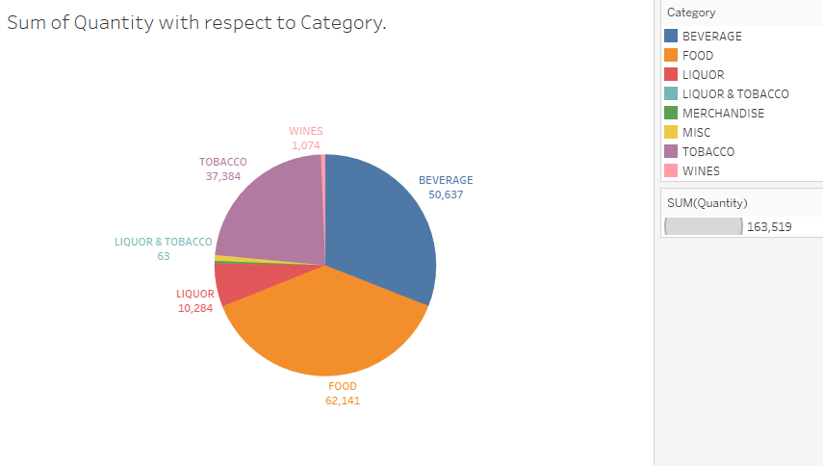
Univariate and Multivariate Analysis
We used Tableau for visualization of univariate and multivariable analysis.
We can observe that the highest quantity is from food. 62,141 units of different items belongs to Food category were sold in the Café.

Slide 9
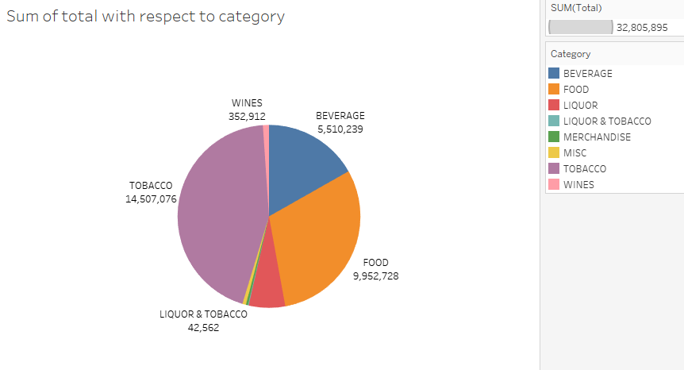
Sum of total with respect to category
We can observe that the Tobacco has the highest total. More than 14 million amount was received. Following which, Food, Beverages has great contribution towards the total

Slide 10
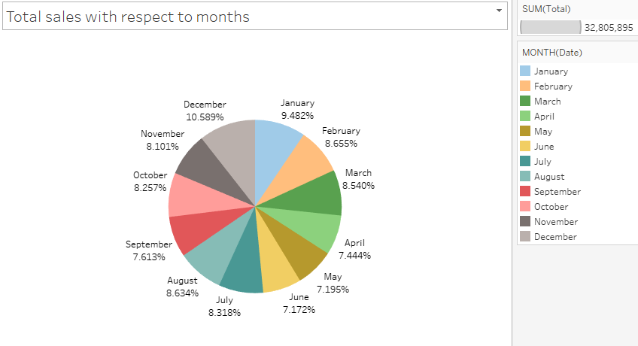
Total sales with respect to months:
The sales across each month are fairly consistent. There is slightly increase in the sales observed in the month of December.

Slide 11
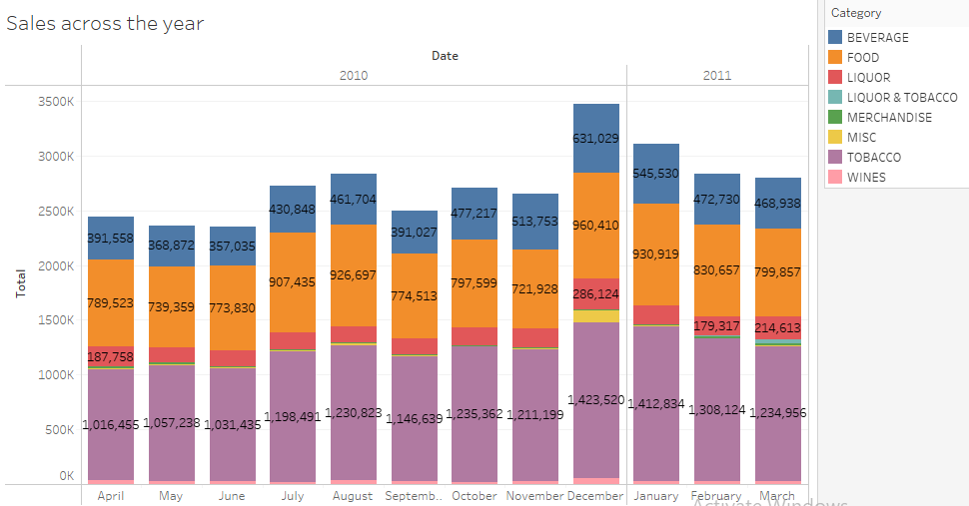
Multivariate Analysis
Sales across the year
As we have observed earlier the sales in December month are high. Here it is evident that the sales is significantly higher in the month of December.

Slide 12
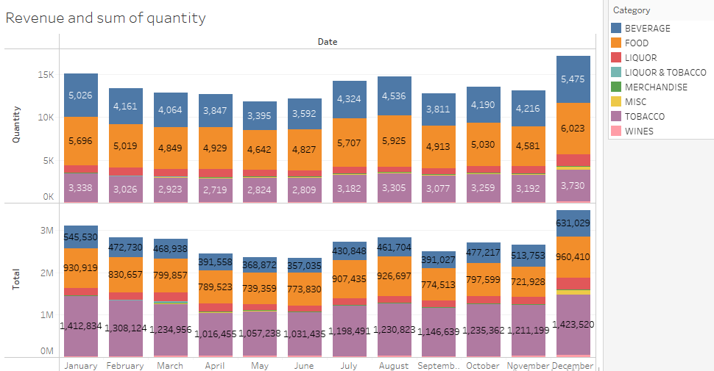
Revenue and Sum quantity
Here we can observe that the total for for Tobacco category is is higher but when it comes to quantity is observed to be low. This may be because of the rate and tax for these items is higher.
The revenue is in higher in the end and beginning of the year.
In July and August, it is observed that the revenue is slightly higher compared to the adjacent months.

Slide 13
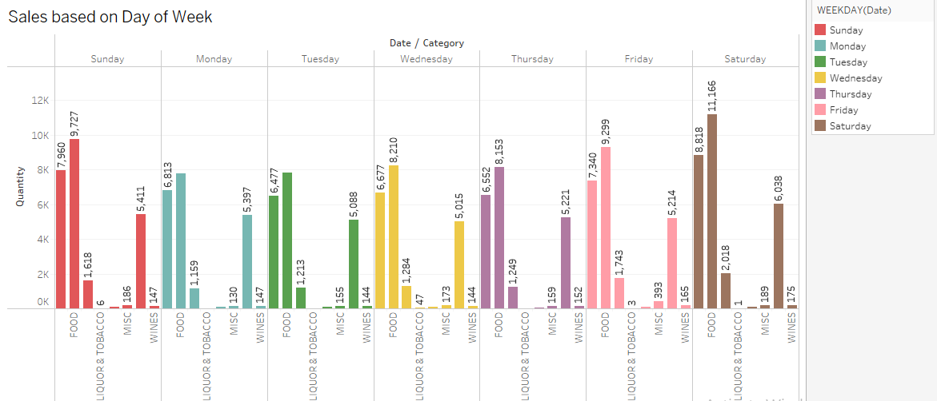
Sales based on Day of Week
Sales in the weekends, that is on Saturday and Sunday are higher in Food and Beverages category. The reason may be the consumers would go out to café in the weekends and prefer food and beverages.
Tobacco sales over the week are consistent. A slight increase we can observe on Saturday.

Slide 14
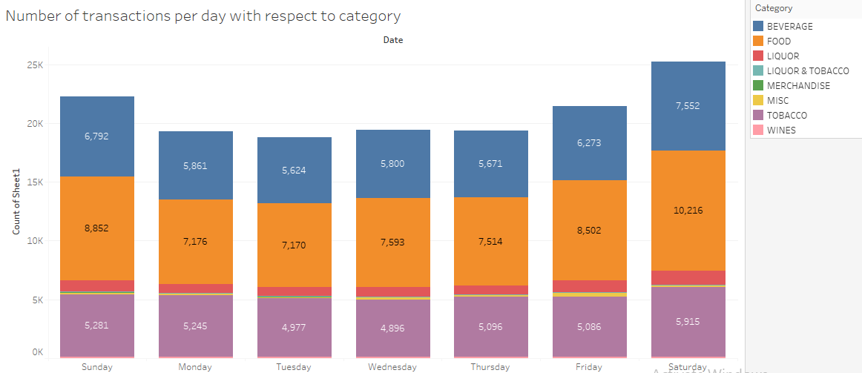
Number of transactions broken on a day level
Transactions are higher on Saturday

Slide 15
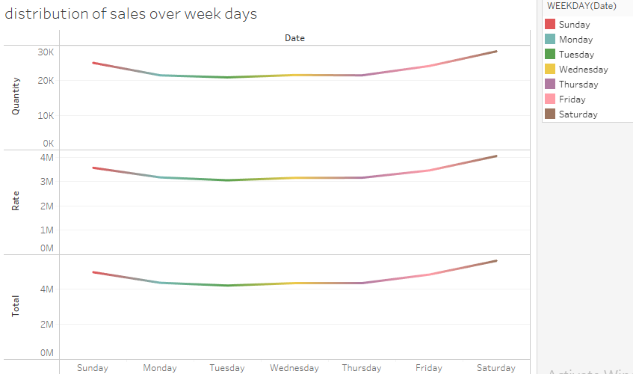
Distribution of Sales over week days.
Sales are distributed across the week evenly and there is no sharp peak.

Slide 16
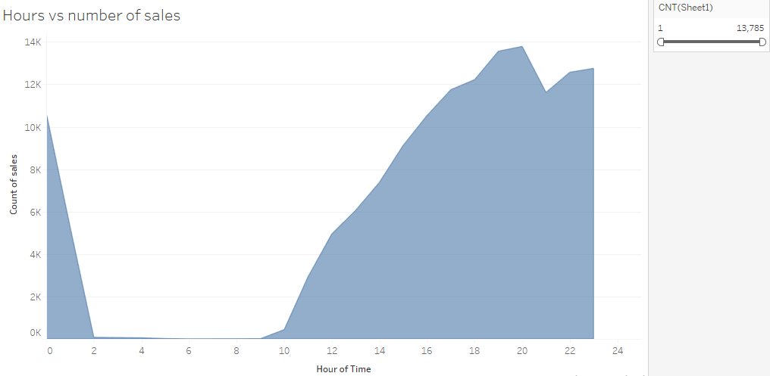
Sales trend across hours
The sales keeps on increasing between 9.30am and 11am. This looks like the café working hours is between 9.30am and 2pm.
There is slight drop in sales between 10.30pm and 12pm. We can interpret that the other café in the locality gets closed early and most consumers tend to visit the café in this time as it is only available café.

Slide 17
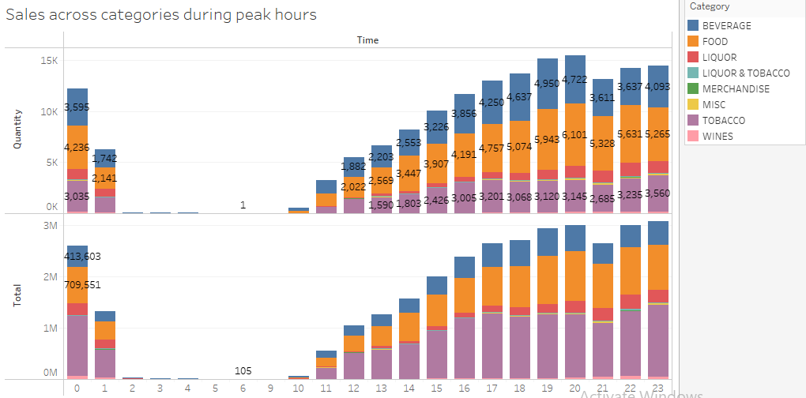
Sales across categories during peak hours

Slide 18
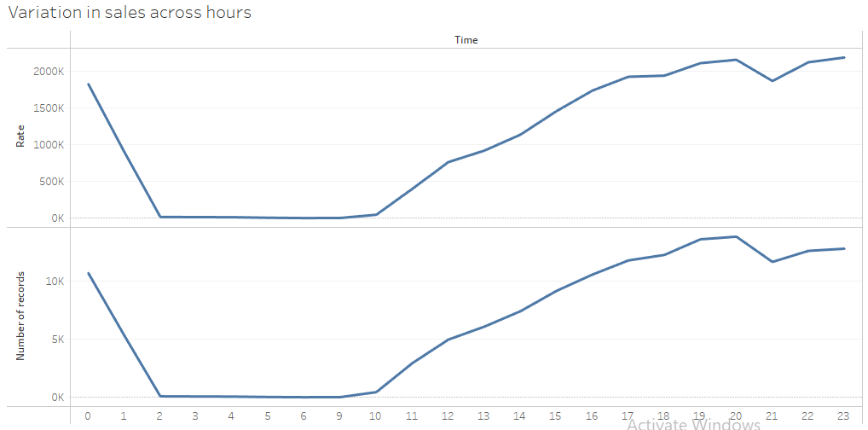
Variation of number of sales and rate across items in different categories
Rate of the items has been constant irrespective of timings.
Hours between 7pm and 11pm can be called as rush hours.

Slide 19
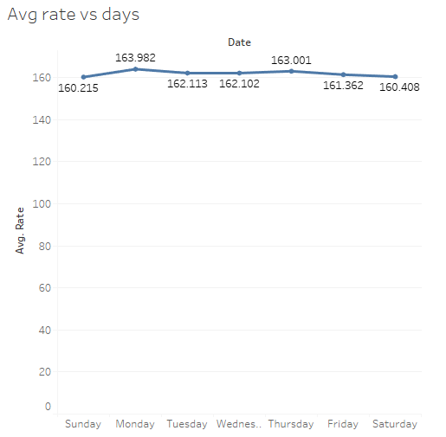
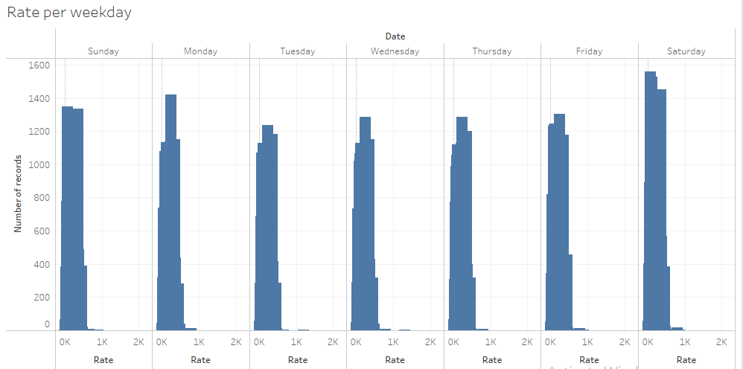
Average revenue
Average revenue is slightly higher on Saturdays.
Avg cost of an item is approx. 160

Slide 20
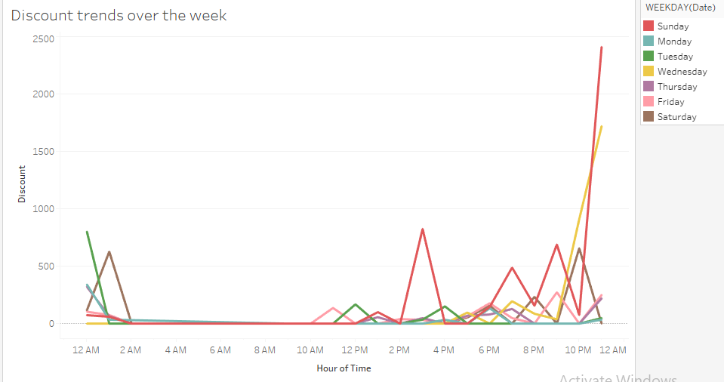
Discount trend over week
The discounts are higher on Wednesday and Sunday
After 10 pm the discounts are higher. Between 6pm and 8pm are considerably higher.

Slide 21
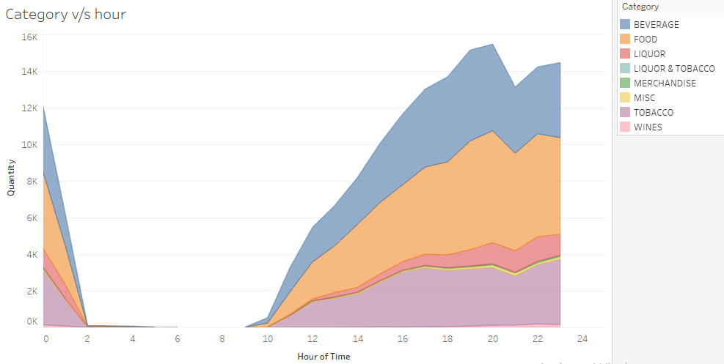
Peak time of sales for various categories
Peak time for all the categories is between 7.30pm and 8pm.

Slide 22
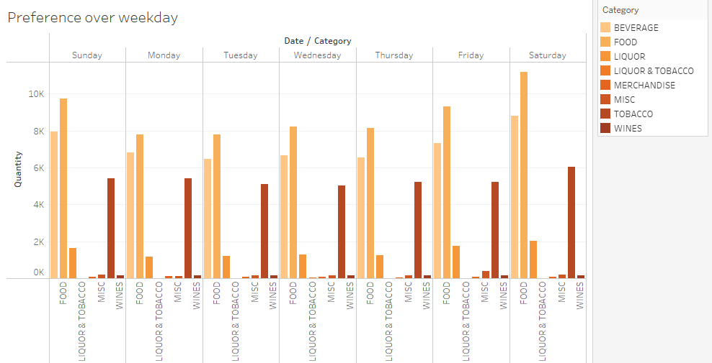
Preferences based on weekday

Slide 23
Summary and Key Findings
The data is constant across weekdays and across months with 20% increase in sales on Saturdays which will be due to weekend rush. Sales gradually increase from Friday, reach a peak on Saturday and is high on Sunday and is constant across weekdays
Café opening hours can be brought down to 16 hours instead of all day as the sales just contribute to 0.2% during few hours in a day. (10am to 2am)

Slide 24
Almost 40% of the sales and Revenue is from Tobacco
Food, Tobacco and Beverages are the top selling categories. These can be considered for combo selection to increase sales
Discounts can be given for bills of higher value and also to customers who frequent the café to ensure they visit again.

Slide 25
Menu Analysis

